Slide 1
Exploring and Clustering Neighborhoods in Tokyo¶
Whether your company is an established, mature business or a start-up, locating in a largely populated city has several benefits. The hustle and bustle of a large metropolis seems to transfer its energy to the businesses and residents. Whether the city is located on the West Coast, the East Coast or in the Midwest, they all share several advantages.

Slide 2
Grocery Stores are often cited as among the types of businesses with the lowest profit margins. It's true. Grocery store profit margins typically range from 1 percent to 3 percent, depending on the items.
Grocery stores make their money on volume. They may not make much on any one item, that's why the store kindly provides big shopping carts for their customers.
Given This, we will employ our skills as a data scientist to identify highly populated Neighborhood where competition are bound to be very minimal.
Advantages of each area in Our Data will then be clearly expressed so that best possible final location can be chosen by stakeholders.

Slide 3
Data acquisition and cleaning
Data containing the 23 special wards in Tokyo was collected from Wikipedia and
scraped using beautiful soup
centers of candidate areas will be generated algorithmically and approximate addresses of
centers of those areas will be obtained using Google Maps API reverse geocoding
In total, 23 rows and 8 columns features in the raw dataset
Duplicate, and Irrelevant columns were dropped
Cleaned data contains 23 rows and 5 columns.

Slide 4
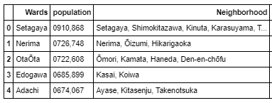
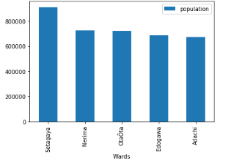
IDENTIFIED TOP 5 POPULATED WARDS AND NEIGHBORHOODS IN TOKYO

Slide 5
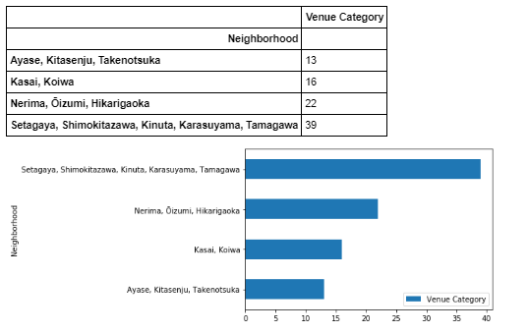
NEIGHBORHOODS BELONGING TO SETAGAYA AND NERIMA TOPS THE CHART FOR TOTAL VENUE CATEGORIES

Slide 6
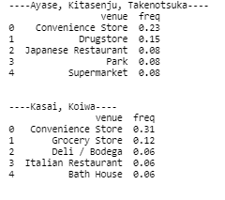
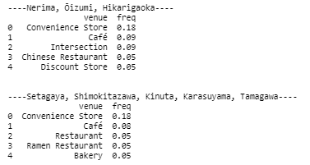
Most venue identified in the neighborhoods are convenience stores, restaurant and café
Setagaya and Nerima featured no Grocery store/ supermarket in its most common venues
Making it a less a competitive and populated location.

Slide 7
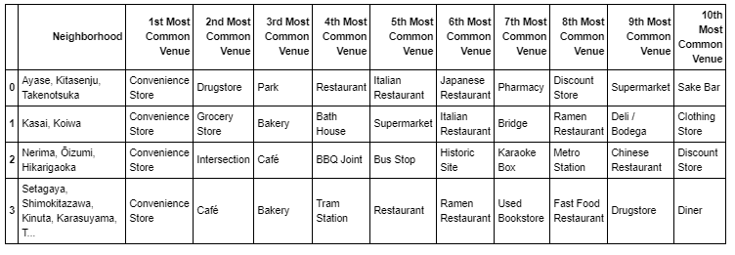

Even at further venue exploration Setagaya and Nerima still proves ideal considering competition
Most Businesses can rely on Groceries stores of close proximity for their daily supply of raw materials
and facilities .

Slide 8
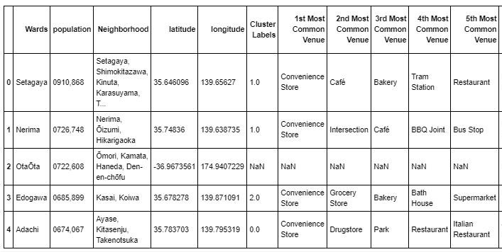
Clustering of Wards

Slide 9
Conclusion
By Exploring Populated Wards and Neighborhoods and Analyzing most common venues from Foursquare data we have first identified general Wards that justify further analysis (Setagaya, Nerima, OtaŌta, Edogawa, Edogawa and Adachi), which satisfy some basic requirements regarding establishment of Grocery stores.
Clustering of those locations was then performed in order to create major zones of interest (containing greatest number of potential locations) and addresses of those zone centers were created to be used as starting points for final exploration by stakeholders.
Final decision on optimal business locations will be made by stakeholders based on specific characteristics of neighborhoods and locations.

